Slide 1
29 02 2024
Damien
Mise en route travail cve et cvss

Slide 2
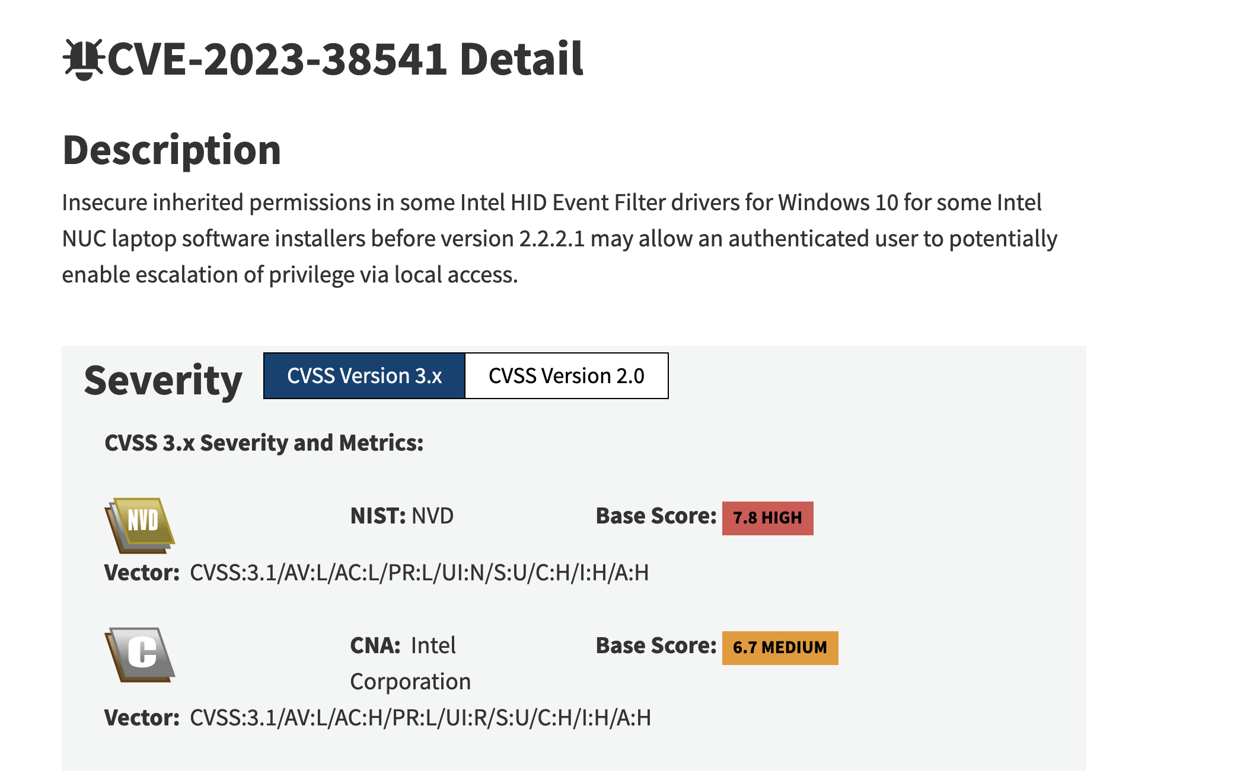
Demande
Objectif :
Un petit programme qui calcule automatiquement les CVSS
En fonction d'entrées qui seront fournies par l'opérateur
https://nvd.nist.gov/vuln/detail/CVE-2023-50930

Slide 3
Description
Insecure inherited permissions in some Intel HID Event Filter drivers for Windows 10 for some Intel NUC laptop software installers before version 2.2.2.1 may allow an authenticated user to potentially enable escalation of privilege via local access.
Vector: CVSS:3.1
/AV:L (ou H ou M)
/AC:L
/PR:L
/UI:N
/S:U
/C:H
/I:H
/A:H

Slide 4
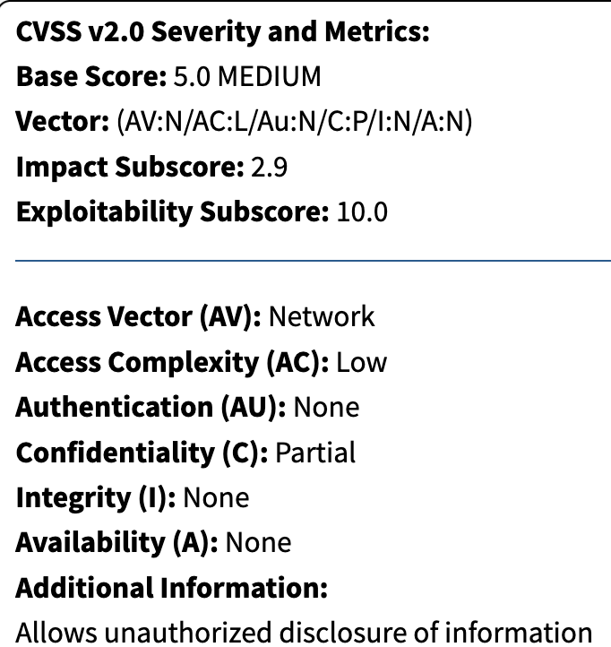
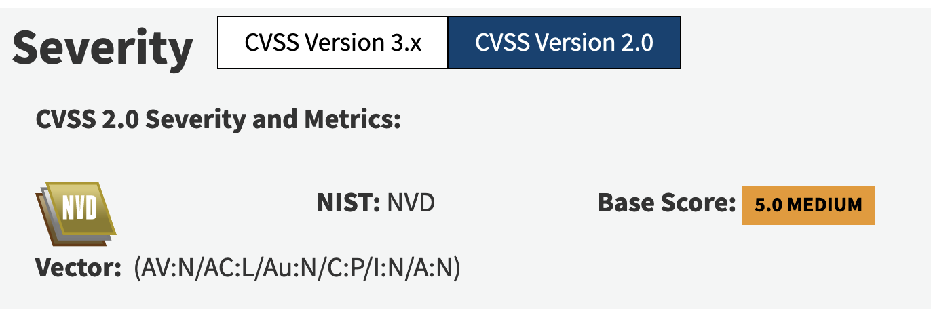
Javascript
FE
Quel est ton AV
/AV:
/AC:
/PR
/UI:
/S:
/C:
/I:
/A:
BE
Calcul du CVSS
https://nvd.nist.gov/vuln-metrics/cvss/v3-calculator?name=CVE-2023-38541&vector=AV:L/AC:H/PR:L/UI:R/S:U/C:H/I:H/A:H&version=3.1&source=Intel%20Corporation

Slide 5
Calcul du CVSS 2,0
DRAFT CVSS v2.10 Equations (last revised 3-20-07)
CVSS Base Score Equation
BaseScore = (.6*Impact +.4*Exploitability-1.5)*f(Impact)
Impact = 10.41 * (1 - (1 - ConfImpact) * (1 - IntegImpact) * (1 - AvailImpact))
Exploitability = 20 * AccessComplexity * Authentication * AccessVector
f(Impact) = 0 if Impact=0; 1.176 otherwise
AccessComplexity = case AccessComplexity of
high: 0.35
medium: 0.61
low: 0.71
Authentication = case Authentication of
Requires no authentication: 0.704
Requires single instance of authentication: 0.56
Requires multiple instances of authentication: 0.45
AccessVector = case AccessVector of
Requires local access: 0.395
Local Network accessible: 0.646
Network accessible: 1
ConfImpact = case ConfidentialityImpact of
none: 0
partial: 0.275
complete: 0.660
IntegImpact = case IntegrityImpact of
none: 0
partial: 0.275
complete: 0.660
AvailImpact = case AvailabilityImpact of
none: 0
partial: 0.275
complete: 0.660
CVSS Temporal Equation
TemporalScore = BaseScore
* Exploitability
* RemediationLevel
* ReportConfidence
Exploitability = case Exploitability of
unproven: 0.85
proof-of-concept: 0.9
functional: 0.95
high: 1.00
not defined 1.00
RemediationLevel = case RemediationLevel of
official-fix: 0.87
temporary-fix: 0.90
workaround: 0.95
unavailable: 1.00
not defined 1.00
ReportConfidence = case ReportConfidence of
unconfirmed: 0.90
uncorroborated: 0.95
confirmed: 1.00
not defined 1.00
CVSS Environmental Equation
EnvironmentalScore = (AdjustedTemporal
+ (10 - AdjustedTemporal)
* CollateralDamagePotential)
* TargetDistribution
AdjustedTemporal = TemporalScore recomputed with the Impact sub-equation
replaced with the following AdjustedImpact equation.
AdjustedImpact = Min(10,
10.41 * (1 -
(1 - ConfImpact * ConfReq)
* (1 - IntegImpact * IntegReq)
* (1 - AvailImpact * AvailReq)))
CollateralDamagePotential = case CollateralDamagePotential of
none: 0
low: 0.1
low-medium: 0.3
medium-high: 0.4
high: 0.5
not defined: 0
TargetDistribution = case TargetDistribution of
none: 0
low: 0.25
medium: 0.75
high: 1.00
not defined: 1.00
ConfReq = case ConfidentialityImpact of
Low: 0.5
Medium: 1
High: 1.51
Not defined 1
IntegReq = case IntegrityImpact of
Low: 0.5
Medium: 1
High: 1.51
Not defined 1
AvailReq = case AvailabilityImpact of
Low: 0.5
Medium: 1
High: 1.51
Not defined 1
NVD CVSS Overall Score Decision Tree
The CVSS Overall Score is part of the NVD and is not part of the CVSS standard.
(Calculate OverallScore)
|
|
\/
<BaseScore Defined?> ----No----> [OverallScore = "Not Defined"] -------------
| |
| |
Yes |
| |
| |
\/ |
[OverallScore = BaseScore] |
| |
| |
\/ |
<EnvironmentalScore Defined?> --Yes--> [OverallScore = EnvironmentalScore] ----|
| |
| |
No |
| |
| |
\/ |
<TemporalScore Defined?> ---Yes---> [OverallScore = TemporalScore] ---------|
| |
| |
No |
| |
| |
\/ |
(Return OverallScore) <-------------------------------------------------------

